Slide 1
Cancer Biology Biol 445
Spring 2020
Dr. Heidi Super
Lecture 17
3-4-2020

Slide 2
Return quiz Friday.

Slide 3
Where were we?
Tumor suppressor genes:
pRB and p53---loss of function mutations:
Occur in single somatic cells leading to cancer of a particular tissue type. (2 hits required.)
Can be inherited in the germline---greatly increasing the likelihood for any cell to be transformed if it acquires a second hit.

Slide 4
Li-Fraumeni syndrome
Named for 2 geneticists who showed the families shared germline p53 mutation.
Li-Fraumeni Syndrome is suspected if the following three criteria are met:
the patient has been diagnosed with a sarcoma at a young age (below 45),
a first-degree relative has been diagnosed with any cancer at a young age (below 45),
and another first-degree or a second-degree relative has been diagnosed with any cancer at a young age (below 45) or with a sarcoma at any age.

Slide 5
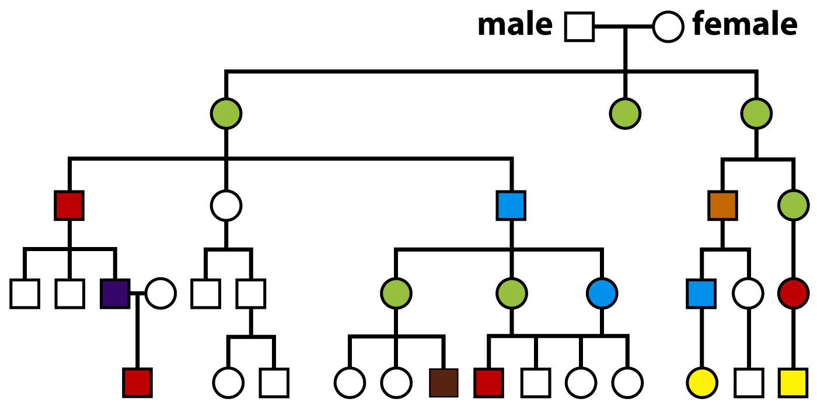
Green=breast cancer
Blue=pancreatic cancer
Purple =lung cancer
Yellow=leukema
Red=all sarcomas
Figure 9.20 The Biology of Cancer (© Garland Science 2007)

Slide 6
A number of viruses disrupt normal function of pRb, p53 or both!
HPV
SV40 virus
Adenovirus
polyomavirus
HTLV (human leukemia virus)
Epstein-Barr virus—associated with mononucleosis and Burkitt’s lymphoma

Slide 7
Last tumor suppressor gene we will discuss in detail
2. CDKN2A gene
---Very interesting gene—it encodes 2 TS proteins at the same time!
The same DNA sequence can be read in 2 different reading frames. Changes the amino acid sequence, but produces 2 functional proteins: p16 and ARF

Slide 8
Alternative splicing of one mRNA creates 2 different messages for translation.
Figure 9.14 The Biology of Cancer (© Garland Science 2007)

Slide 9
p16 normally inhibits the activity of cyclin-CDK pairs which phosphorylate pRB.
Arf normally inhibits the activity of Mdm2.
Figure 10-11
Be sure to review how, specifically, LOSS of these genes/proteins would be associated with cancer.

Slide 10
Interesting and puzzling that mammals have a single DNA region so important to normal cell division!
Loss/serious alteration of this region, disrupts our 2 most important TS gene pathways.

Slide 11
Summarizing…
Thus far we have summarized the tumor suppressor genes we consider Gatekeeper genes.
These play some role in stopping an important signal transduction pathway that ultimately leads to cell division OR they play a role in inducing cell cycle pause or apoptosis.

Slide 12
Second type of TS gene/protein
Also protect the cell, but indirectly, by limiting mutation rate for all genes .
These are sometimes called the CARETAKER genes to clarify a different type of activity.
Examples--
DNA repair proteins (introduced briefly before)
Mitotic spindle regulators

Slide 13
Loss of function mutations in these genes set the stage for genetic instability.
Increases the likelihood that proto-oncogenes are altered (overactive or amplified) to become oncogenes.
Increases the likelihood that TS genes are inactivated.

Slide 14
Again, inherited/familial types of cancer revealed the existence of some of these genes/proteins.
Why? Because, even if both alleles of a gene must be mutated to cause disease, inheriting one defective allele greatly increases the rate/likelihood that the second “hit” will occur in the same cell. Whose hypothesis?...

Slide 15
Cancers associated with defective DNA repair.
1. HNPCC---hereditary nonpolyposis colon cancer (formerly known as Lynch syndrome)
Linked to recessive mutation in mismatch repair gene. Incredibly important as DNA mismatches occur during DNA replication all the time!
Left, unrepaired, a second round of replication changes the DNA sequence forever in one of the daughter cells.
Figure 2-7

Slide 16
Familial HNPCC actually looks like a dominant genetic disease!
Once a cell loses the ability to perform mismatch repair, the rate of mutation of other critical cancer-related genes is rapid and frequent.
No need for additional outside mutagenic forces.
Figure 10-12

Slide 17
About 75% of people who inherit a mutation on one of the mismatch repair protein genes eventually develop colon cancer!
Smaller risk for uterine, stomach, kidney, and ovarian cancer.
Little risk for other types of cancer.

Slide 18
Xeroderma pigmentosum
Another cancer syndrome associated with increased skin cancer risk.
Result of defective excision repair. Type of repair needed to fix pyrimidine dimers induced by UV radiation.2-15

Slide 19
Since XP requires exposure to UV to establish genetic instability, this syndrome essentially takes an additional “hit” to develop, compared to HNPCC. However, being alive generally means regular sun exposure.
Since skin cells are the most readily targeted cell type for UV radiation, this repair defect is associated specifically with skin cancer.

Slide 20
BRCA1 and BRCA2
Once thought to be oncogenes, both encode double-strand repair proteins.
When missing from a cell, the cell is much more prone to DNA damage by agents that induce DS breaks. Defect in DS break repair.

Slide 21
BRCA1/2 interactions
10-13---Recall ATM. Activated by DNA damage of various kinds.
ATM activates p53 allowing it to pause cell cycle.
ATM also activates BRCA1 to participate in homologous DNA repair. (joins Rad50 exonulease complex).

Slide 23
BRCA2 interacts with a second complex (Rad51) to a second step in ds DNA repair.
see text
Figure 10-13.

Slide 24
Second class of caretaker TS genes…
Genetic instability can be the result of defective segregation of chromosomes during mitosis. (Usually the result of defective Mitotic spindle regulators)
Results in gains or losses of whole chromosomes=aneuploidy

Slide 25
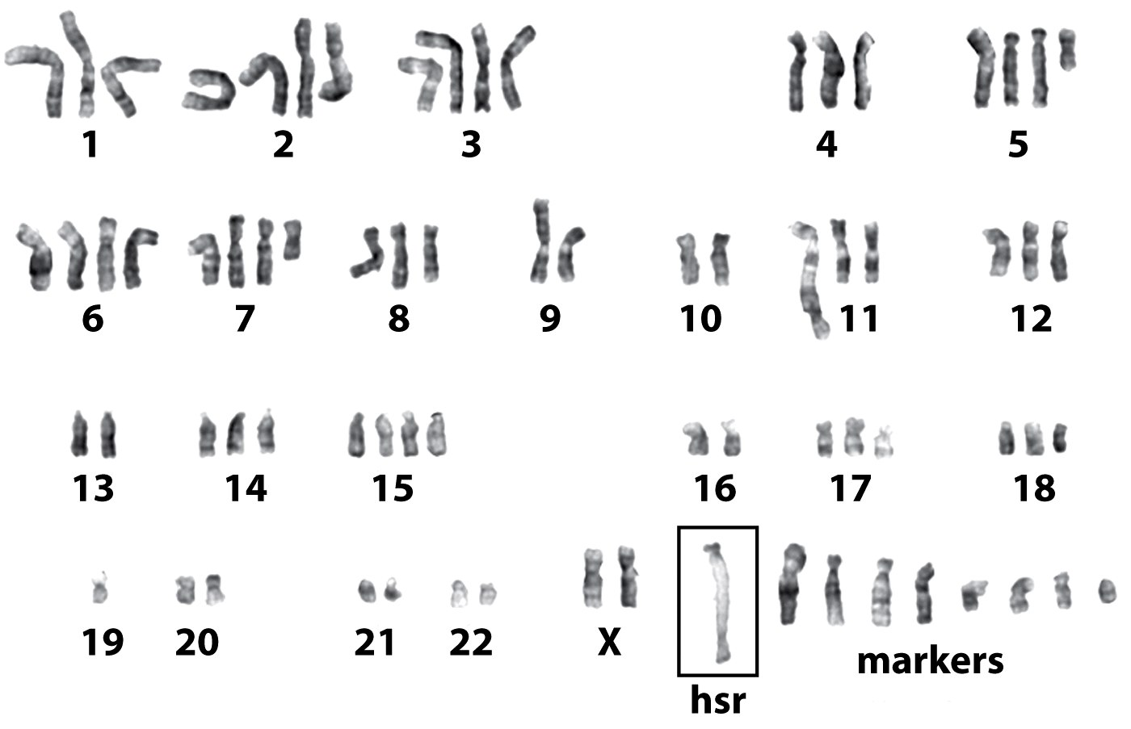
In this cancer cell, very few chromosomes have 2 copies!
YIKES!
Figure 1.12a The Biology of Cancer (© Garland Science 2007)

Slide 26
Recall a critical point in cell division is Metaphase—Chromosomes align at the center of the cell.
More than that…they attach to spindle fibers such that each sister chromatid is attached to fibers going to opposite poles in the cell

Slide 27
Proteins called cohesins hold sister chromatids together until proper attachment is complete.
Once chromosomes are attached to the spindle, anaphase begins and sister chromatids separate.

Slide 28
A complex of proteins push the cell into anaphase= Anaphase-promoting complex
--One key member of the complex=cdc20
Cdc20 activates a protein called separase, which breaks down cohesins, allowing sister chromatids to separate.

Slide 29
Cells use at least 2 types of proteins to prevent anaphase from starting before chromatids are attached to the spindle.
Mad and Bub family proteins bind to chromosomes still unattached to spindle fibers and prevent initiation of anaphase.

Slide 30
Mechanism?
Mad-Bub complex inhibits action of cdc20
Loss of function of Mad or Bub proteins results in premature inititiation of anaphase---improper segregation of chromosomes in Mitosis—aneuploidy.

Slide 32
Time to summarize
Topics of Chapters 9 and 10 give a good survey of oncogenes and tumor suppressor genes.
Recall cancer is the result of the accumulation of mutations in multiple genes---tumor progression is the result of both gain and loss of function of specific proteins.

Slide 33
Most cancers show a rather slow progression to full blown malignancy. In many cases, the steps of progression are similar.
Many cancers have a “pre-cancer” phenotype which alerts physicians to intervene.

Slide 34
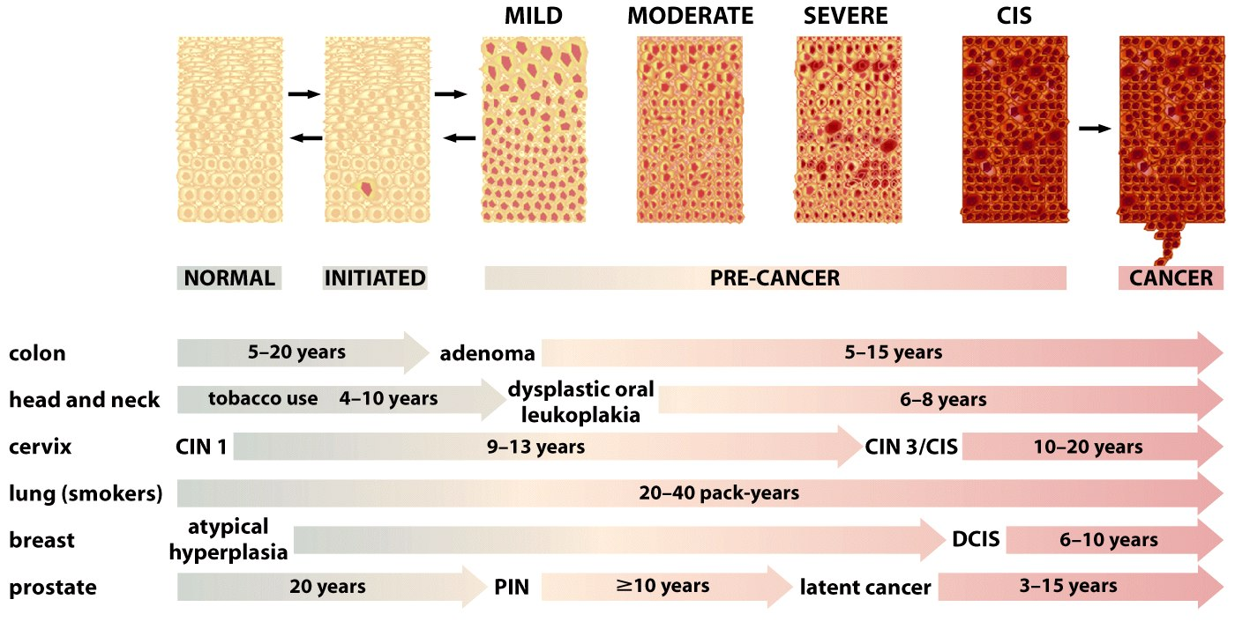
Figure 11.7 The Biology of Cancer (© Garland Science 2007)

Slide 35
Colon cancer provides one of the best models to illustrate how tumor progression can be marked by new genetic changes in one cell in a developing tumor.
10-19

Slide 36
Figure 11.9 The Biology of Cancer (© Garland Science 2007)

Slide 37
Figure 11.10 The Biology of Cancer (© Garland Science 2007)

Slide 38
Re-read chapters 9 and 10. Correlate with notes and lecture material.
Read chapter 8---Heredity and Cancer---p. 140-152 (through first paragraph). Correlate with notes and lecture material.
Re-read the Hallmarks paper---highlight genes you know about and get you gene table up to date.

